Slide 1



TEAM 1 - BATCH 2
Capstone Project
Lenders & Co.
TEAM MEMBERS
ANISH PAREKH
HARSHITA PENDYALA
MOUNVI PODAPATI
OM KULKARNI
PRATHAMESH BONDE

Slide 2

LENDERS & CO.
OUTLINE
INTRODUCTION
AIM & OBJECTIVES
USER FEATURES
ADMIN FEATURES
TOOLS & TECHNOLOGIES
UI SCREENSHOTS
TEST COVERAGE DETAILS
FUTURE SCOPE
REFERENCES & LINKS

Slide 3
LENDERS & CO.
INTRODUCTION
Lenders & Co. introduces an innovative solution poised to transform the management of employee benefits at GIS Global. The solution is crafted with a focus on simplicity, aiming to streamline the way GIS Global employees handle their benefits. It places a strong emphasis on granting employees convenient access to GIS Global Mart, coupled with flexible loan options for a diverse range of purchases.
The primary objective here is to elevate the overall employee experience by simplifying benefit management and facilitating access to an array of product categories. In the following sections, we will delve into the key features and functionalities of this solution, demonstrating its effectiveness in making benefit management effortless for GIS Global employees.

Slide 4

OBJECTIVES
LENDERS & CO.
Enable GIS Global employees to easily access and apply for various loan cards and benefits.
Provide administrators with efficient tools for managing user data, loan cards, and benefits.
Ensure data accuracy, security, and accessibility through robust backend and frontend systems.
Enhance the overall employee experience by simplifying benefit applications and approvals.
Support future scalability and integration with GIS Global's existing systems for seamless operations.
These objectives collectively aim to improve the efficiency and effectiveness of GIS Global's employee benefits and loan management processes.
AIM
To develop user-friendly applications that streamline and enhance the management of employee benefits and loan programs for GIS Global.

Slide 5
LENDERS & CO.
USER FEATURES
User-friendly Interface
Login and Credential Validation
Loan Application
offers an intuitive and user-friendly interface, making it easy for GIS Global employees to navigate and utilize its features.
allows users to securely log in, ensuring that only authorized personnel can access the system.
Loan Application Employees can easily apply for a loan within the application, simplifying the process of acquiring funds for various purchases.
Flexible Loan Options
Loan Card Management
Item Purchase Tracking
provides flexible loan options tailored to different purchase categories, accommodating a wide range of employee needs.
offers a comprehensive loan card management system, enabling users to view, manage, and monitor their loan cards.
Users can easily track and view all the items they've purchased using their loan cards, providing transparency and accountability.

Slide 6
LENDERS & CO.
ADMIN FEATURES
Efficient Customer Data Management
Comprehensive Loan Card Control
Streamlined Item Catalog Maintenance
Simplifies the process of managing customer data, enabling administrators to add, edit, and maintain essential information with ease.
Administrators have complete control over loan cards, allowing them to efficiently oversee and manage loans, including adding, deleting, or updating loan cards as needed.
Simplifies item management, making it easy for administrators to maintain the catalog of available products, ensuring it remains up-to-date and accurate.

Slide 7
LENDERS & CO.
Tools & Technologies
Databases: MariaDB
Presentation Layers: React
Backend Processing: Springboot
Database Connectivity: Spring Data JPA
Version Control Systems: Git
Build Tools: Maven
Integrated Development Environments: VS Code and Eclipse
API Testing: Postman
Database Management: HeidiSQL
Testing Frameworks: JUnit and Mockito

Slide 8

LENDERS & CO.
ADMIN MODULES
About Page
Login Page
Add Customer
All Customer
All Items
Add Loan
All Loans
Add Item
USER MODULES
About Page
Login Page
Apply Loan
View Loans
Items Bought

Slide 9
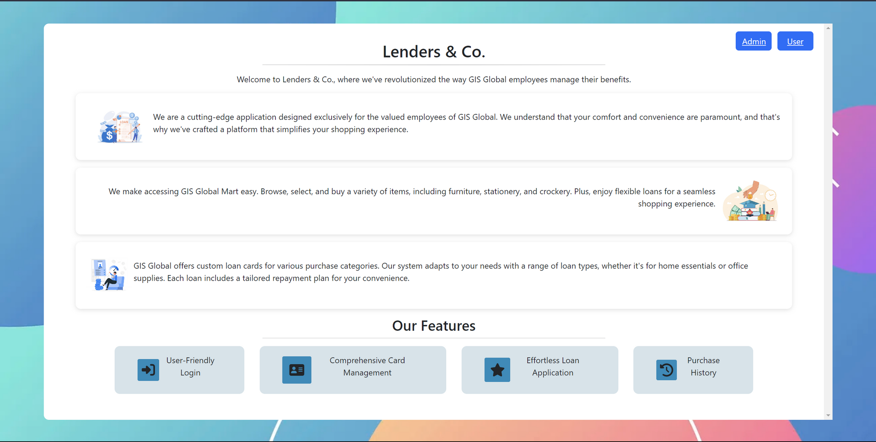
About Page

Slide 10
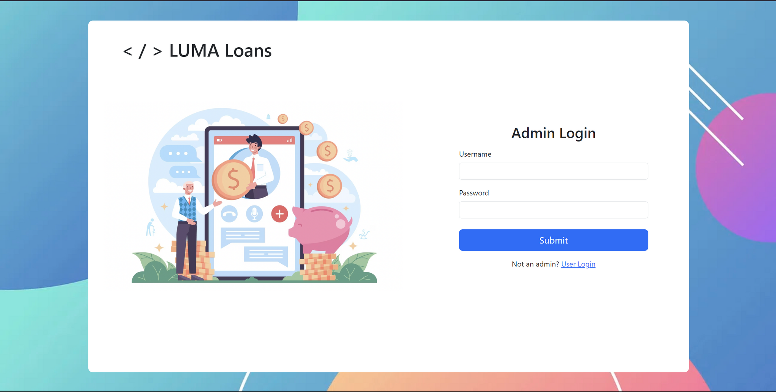
Login Page

Slide 11
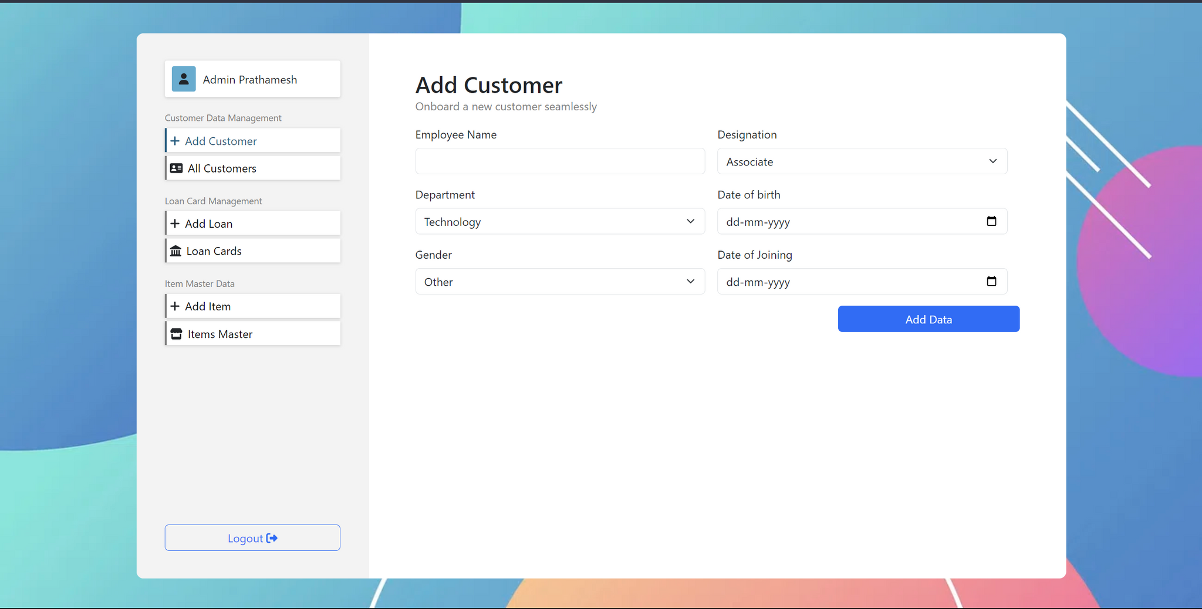
Form Format

Slide 12
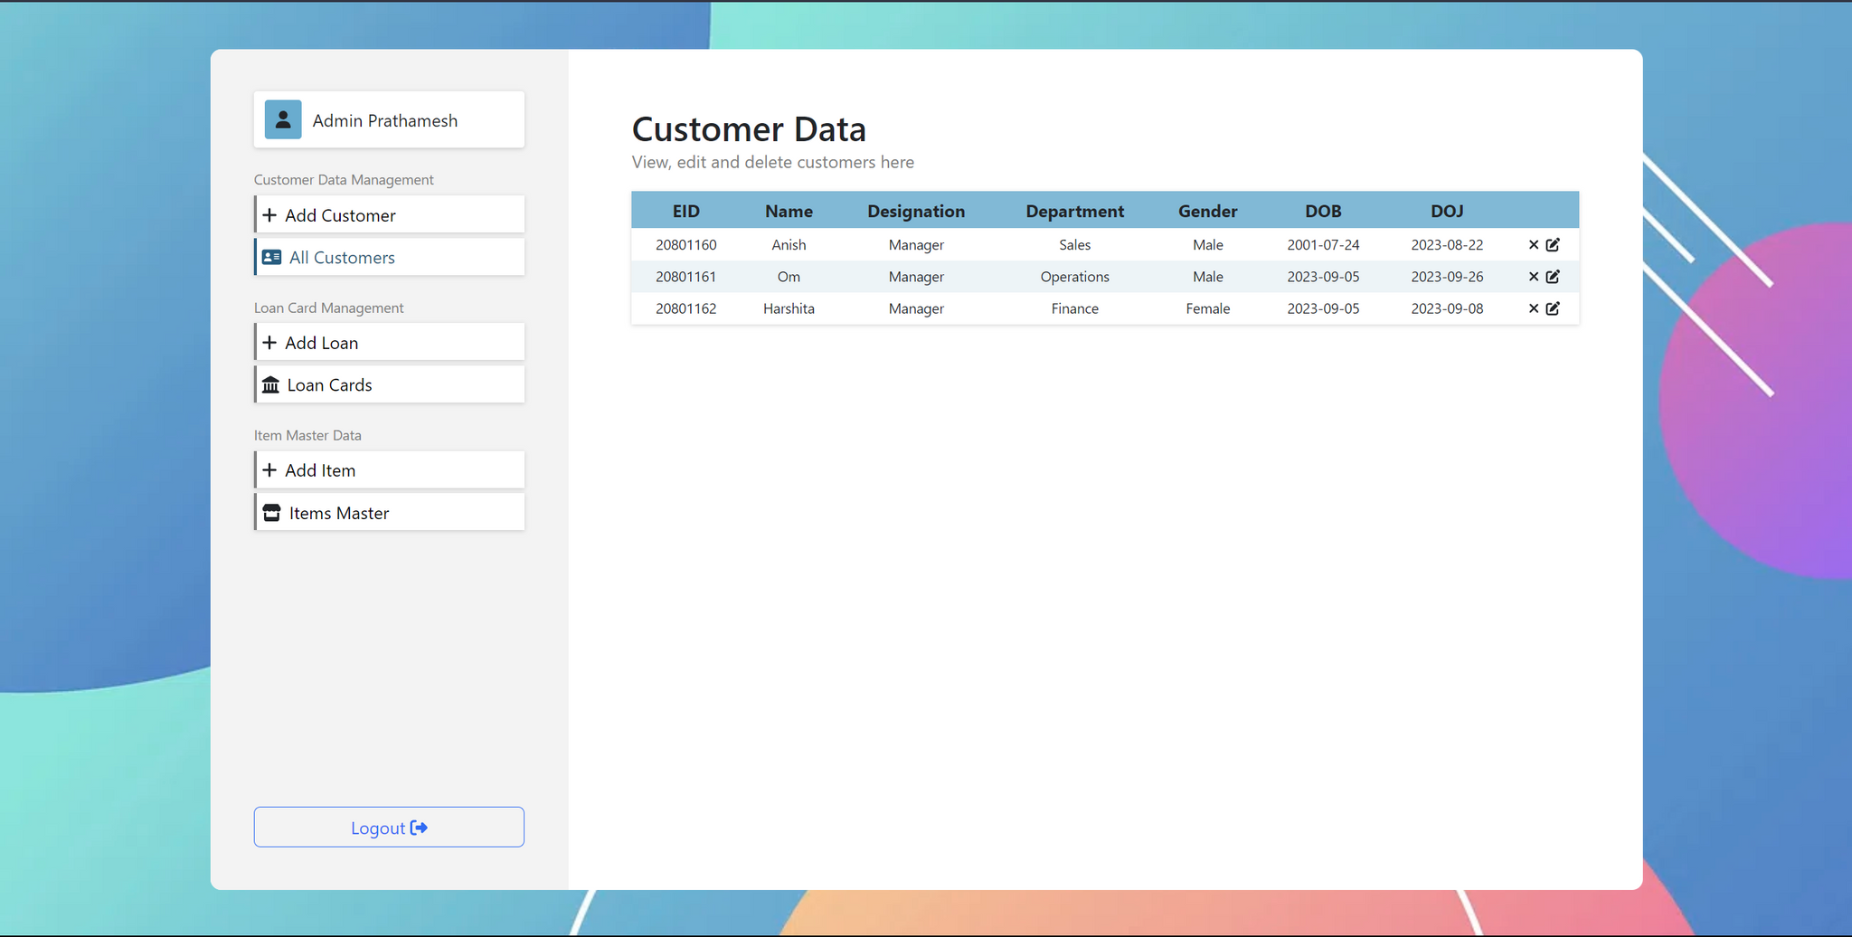
Table View

Slide 13
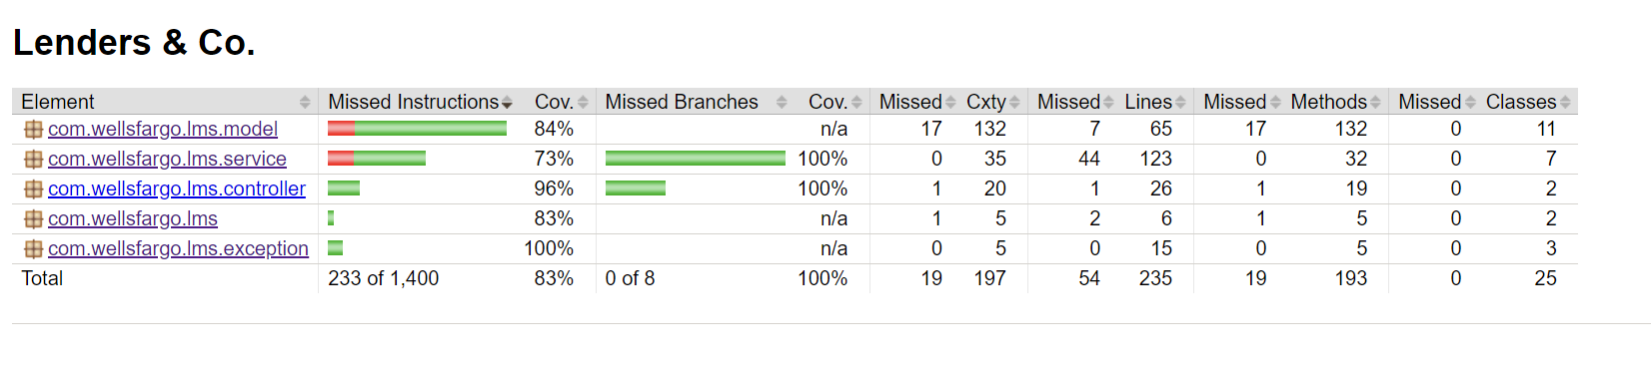
LENDERS & CO.
TEST COVERAGE

Slide 14

LENDERS & CO.
FUTURE SCOPE
Advanced Reporting and Analytics
Enhance insights for data-driven decisions and benefit program improvement.
Mobile App Development
Create a mobile app for on-the-go benefit and loan card management.
Financial System Integration
Seamlessly integrate with financial systems for expense tracking and automation.
Automated Repayments
Implement automatic loan repayment options for efficiency.
AI-Powered Personalization
Utilize AI for tailored product recommendations, enhancing the shopping experience.

Slide 15
LENDERS & CO.
REFERENCES & LINKS
GITHUB
01
FRONTEND:- https://github.com/mounvip1525/LMS_Frontend
BACKEND:- https://github.com/Badshah2507/LMS_BackEnd
02
VIRTUAL MENTORING SESSIONS
Trainer Name:- Rajashekar
WEB MATERIAL
03
https://www.w3schools.com/react/default.asp
https://www.baeldung.com/spring-boot
https://react-bootstrap.netlify.app/docs/components/

Slide 16

LENDERS & CO.
Thank You
TEAM 1 - BATCH 2

